Slide 1
SUPERVISED LEARNING
with Python Scikit-Learn
k-Nearest Neighbors
February 2023

Slide 2
Objectives
Introduce the general “pipeline” when using machine learning methods
Demonstrate a Python application for k-Nearest Neighbors (kNN) using scikit-learn

Slide 3
Overview
The Black Box
Using models or methods without the need to know how it works
“Plug and Play”: use inputs, get output
In this slide set, we use a black box kNN model; this can be swapped with other machine learning methods
< insert classification method here >

Slide 4
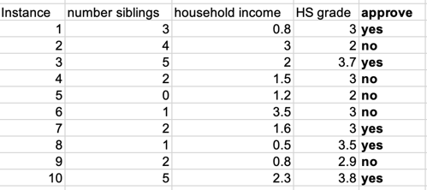
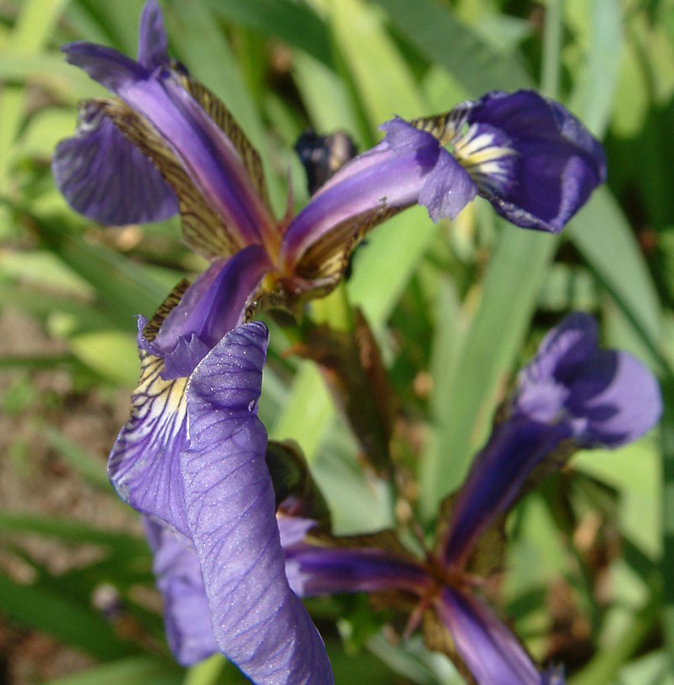
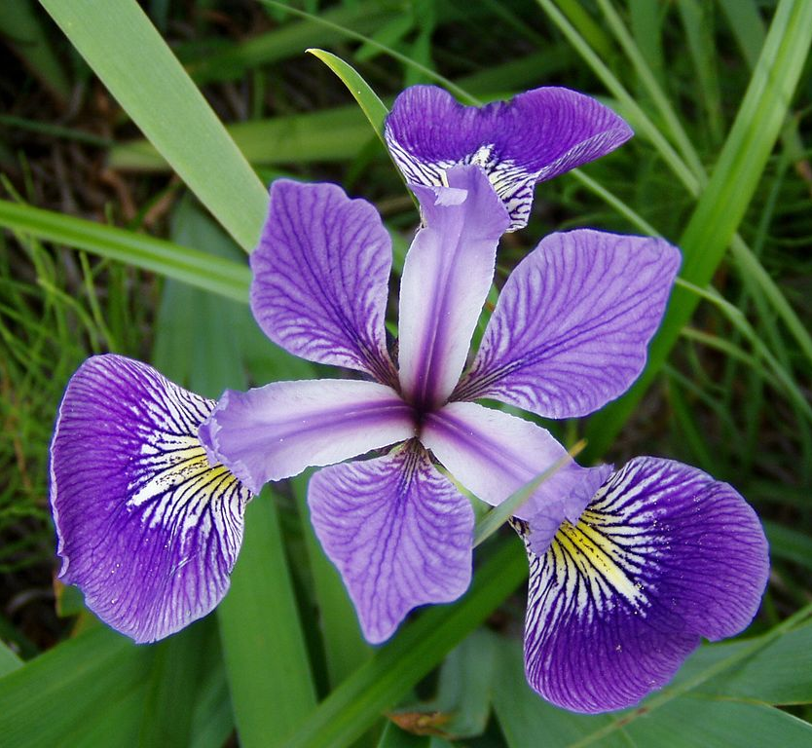
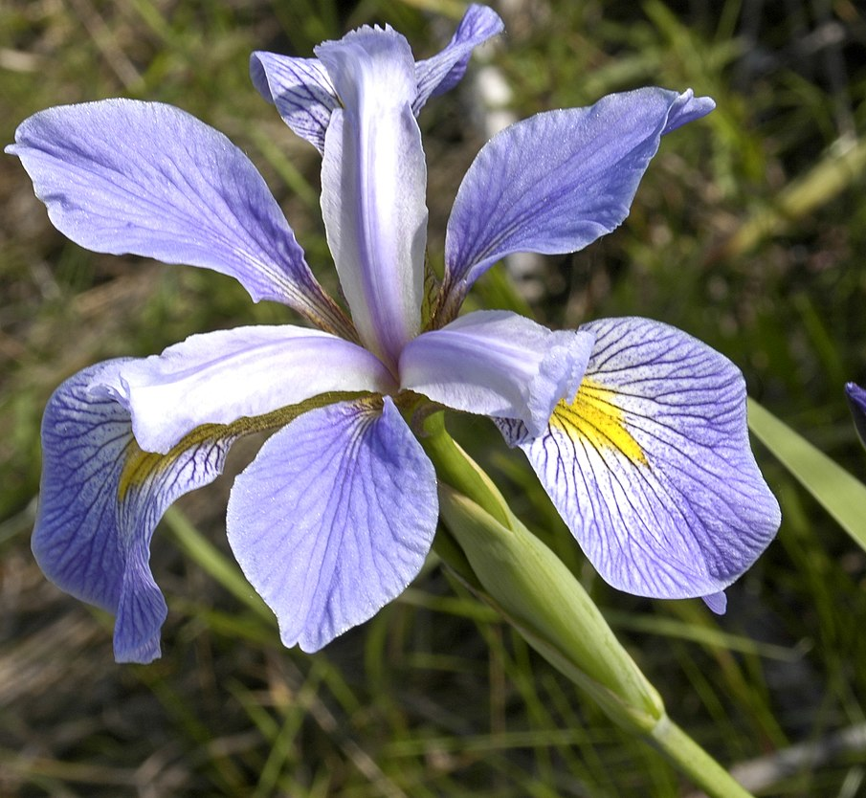
Dataset Examples
Scholarship Application
Dataset for scholarship approval (fabricated)
From previous lesson
Iris Dataset
Dataset for different Iris Species
From scikit-learn
Iris setosa
Iris versicolor
Iris viriginica
Images from Iris Flower Dataset Wikipedia page

Slide 5
Overview
When working with most models:
Prepare the Dataset
Train the Model
Test the Model
Evaluate Results

Slide 6
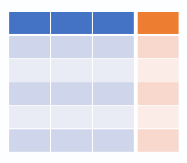






Overview
DATA PREPARATION
TRAINING SET
RAW DATA
FEATURES
LABELS
TEST SET

Slide 7
Data Preparation
How do we translate “objects” into data that machines can understand?

Slide 8
Data Preparation
FEATURES
LABELS
Structured Data
Instances (rows)
Features (columns)
Label

Slide 9
Data Preparation
RAW DATA
FEATURES
LABELS

Slide 10
Data Preparation
RAW DATA
Love this game! So fun and casual friendly
Wow gotta love how this crashes every minute :)
dead game

Slide 11
Data Preparation
RAW DATA
Love this game! So fun and casual friendly
FEATURES
LABELS
Positive words | Negative words | Total words
4 | 0 | 8
3 | 1 | 9
0 | 1 | 2
Positive
Negative
Negative
Wow gotta love how this crashes every minute :)
dead game

Slide 12
Data Preparation
FEATURES
LABELS
SCHOLARSHIP APPLICATIONS

Slide 13
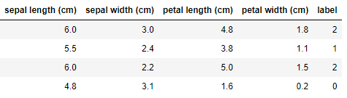
Data Preparation
IRIS FLOWERS
FEATURES
LABELS

Slide 14
Data Preparation
To evaluate a classification model, we need separate datasets for training and testing
TRAINING SET
FEATURES
LABELS
TEST SET

Slide 15
Overview
DATA PREPARATION
TRAINING SET
RAW DATA
FEATURES
LABELS
TEST SET

Slide 16
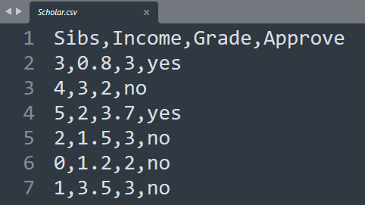
Data Preparation (Python Application)
Structured Data
Can be stored in a format like .csv (comma separated values)
Can be retrieved from some data sources or packages
Often in table format

Slide 17
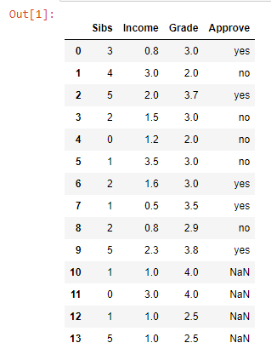

Data Preparation (Python Application)
Scholarship Application
Saved in a .csv file named “scholar.csv”
Retrieved as a DataFrame using pandas read_csv()

Slide 18
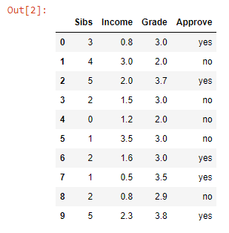
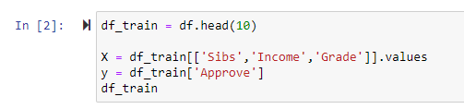
Data Preparation (Python Application)
Scholarship Application
Training set: first 10 instances
Variables
X - features
y - labels

Slide 19
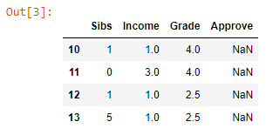

Data Preparation (Python Application)
Scholarship Application
Test set: last 4 instances
Variables
samples - features

Slide 20
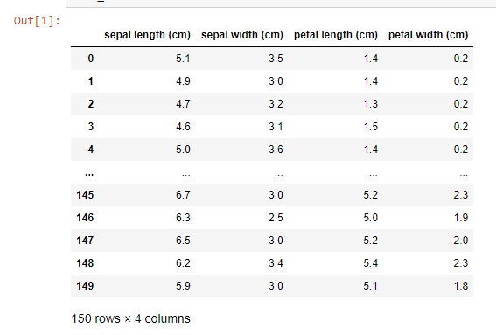
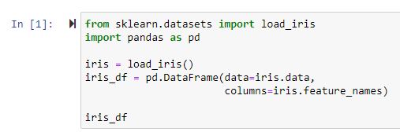
Data Preparation (Application)
Iris Dataset
from Python’s scikit-learn datasets
Saved in a DataFrame

Slide 21
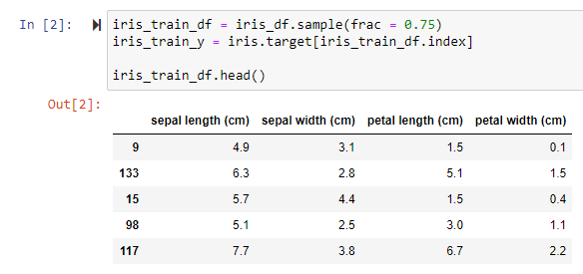
Data Preparation (Application)
Iris Dataset
Training set: 75% of the original dataset (random sample)
Variables
iris_train_df - features
iris_train_y - labels

Slide 22
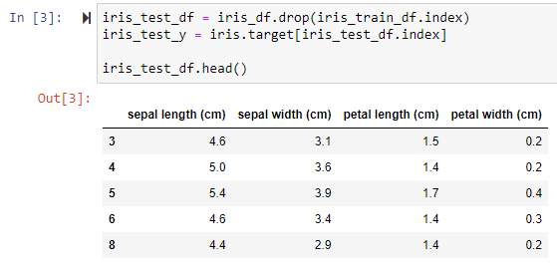
Data Preparation (Application)
Iris Dataset
Test set: other 25% of the dataset
Variables
iris_test_df - features
iris_test_y - labels

Slide 23
Overview
DATA PREPARATION
TRAINING SET
RAW DATA
FEATURES
LABELS
TEST SET

Slide 24
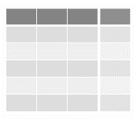
Overview
DATA PREPARATION
TRAINING SET
RAW DATA
FEATURES
LABELS
TEST SET

Slide 25
Overview
TRAINING THE MODEL
TRAINING SET
MODEL
(UNTRAINED)
FEATURES
LABELS
PARAMETERS

Slide 26
Training The Model
Model
Source: from scratch or import from an existing package (e.g. sklearn)
Input: Training Set
Features
Labels
Parameters
e.g. : for kNN, k is a parameter

Slide 27


Training The Model (Application)
Import the model from a package (sklearn)
Create an instance of the model
Train the model (often using the fit() function)
…

Slide 28
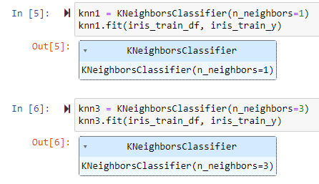
Training The Model (Application)
You can create multiple models with different parameters
k = 1
k = 3

Slide 29

Training The Model (Application)
Scholarship Application
Training set: first 10 instances
X - features
y - labels

Slide 30

Training The Model (Application)
Iris Dataset
Training set: 75% of the original dataset Variables
iris_train_df - features
iris_train_y - labels

Slide 31
Overview
TESTING MODEL
PREDICTED LABELS
TEST SET
MODEL
(TRAINED)
FEATURES

Slide 32
Testing The Model
Input
Test set: features only
Output
The trained model’s predicted label for each instance

Slide 33

Testing The Model (Application)
Scholarship Application
Test set: last 4 instances
samples – features of test set
Output: array

Slide 34
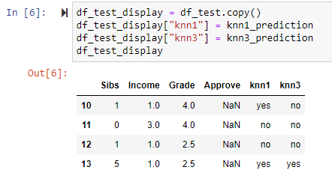
Testing The Model (Application)
Scholarship Application

Slide 35

Testing The Model (Application)
Iris Dataset
Test set: 25% of the original dataset Variables
iris_test_df - features

Slide 36
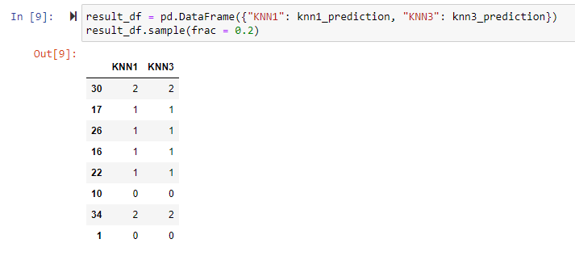
Testing The Model (Application)
Iris Dataset

Slide 37
Overview
RESULT EVALUATION
PREDICTED LABELS
VS
TRUE
LABELS
# correct predictions
accuracy =
# total predictions
predicted label
 | YES | NO
YES
NO
true label

Slide 38
Evaluate Results
Evaluation
We can evaluate results if we have the true labels for the test set
Evaluation Method
Accuracy
Confusion Matrix
PREDICTED LABELS
VS
TRUE
LABELS

Slide 39
Testing The Model (Application)
Scholarship Application
No way to verify if predicted label is correct with a fabricated dataset (no “ground truth”)
Iris Dataset
We can evaluate results through:
the model’s score() method: returns the accuracy of results
sklearn’s confusion_matrix() function

Slide 40


Testing The Model (Application)
Iris Dataset
model_name.score(features, true_labels)
confusion_matrix(labels, predicted_labels)

Slide 41
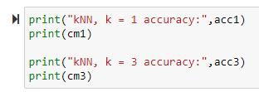
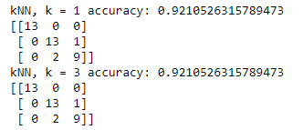
Testing The Model (Application)
Iris Dataset
In this run, kNN with k=1 and k=3 yield the same results.
Note: the train and test set in this slides’ example are generated through random sampling, so the results will be different when the code is run again because the test set is different

Slide 42
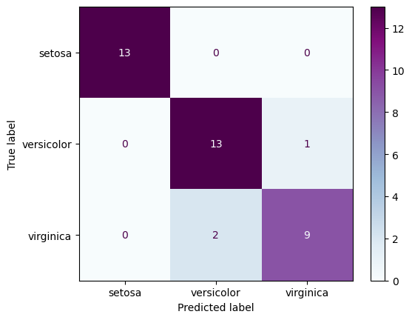
Testing The Model (Application)
Iris Dataset
Plot uses matplotlib and sklearn
Labels show the three Iris species being classified (setosa, versicolor, virginica)

Slide 43
Overview
DATA PREPARATION
TRAINING SET
RAW DATA
FEATURES
LABELS
TEST SET

Slide 44
Overview
MODEL TRAINING
FEATURES
LABELS
MODEL
(UNTRAINED)
PARAMETERS

Slide 45
Overview
MODEL TESTING
TEST FEATURES
PREDICTED LABELS
MODEL
(TRAINED)

Slide 46
Overview
RESULT EVALUATION
PREDICTED LABELS
VS
TRUE
LABELS
# correct predictions
accuracy =
# total predictions
predicted label
 | YES | NO
YES
NO
true label

Slide 47


Conclusion
The Black Box
We can follow the same steps, but using a different classifier from sklearn or other packages
Can easily compare one method to another and evaluate what works best with the dataset
< insert classification method here >

